Slide 1
Chapter 2 Objectives
The CCNA Topics Covered in this chapter include:
  How OSPF works?
  Why Hierarchical Structure?
  Difference between link state and distance vector
  OSPF configuration and verification

Slide 2
Introducing OSPF
  Open standard
  Shortest path first (SPF) algorithm
  Link-state routing protocol (vs. distance vector)
  Can be used to route between AS’s

Slide 3
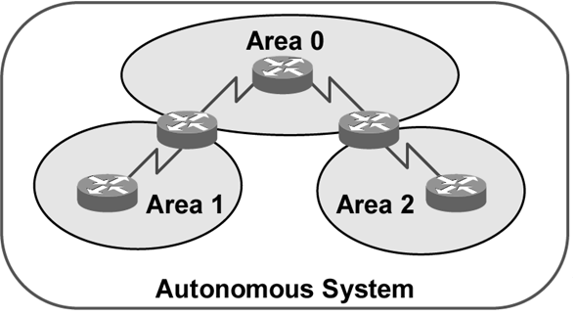
OSPF Hierarchical Routing
  Consists of areas and autonomous systems
  Minimizes routing update traffic
  Supports VLSM
  Unlimited hop count
  Allows scalability

Slide 4
Distance Vector vs. Link State
Distance Vector
Updates frequently
Each router is "aware" only of its immediate neighbors
Slow convergence
Prone to routing loops
Easy to configure
Link State
Updates are event triggered
Each router is "aware" of all other routers in the "area"
Fast convergence
Less subject to routing loops
More difficult to configure

Slide 5
OSPF Terms
Link
Router ID
Neighbours
Adjacency
OSPF Area
Backbone area
Internal routers
Area Border Router (ABR)
Autonomous System Boundary Router (ASBR)

Slide 6
Link
A network or router interface assigned to a given network
Link (interface) will have "state" information associated with it
  Status (up or down)
  IP Address
  Network type (e.g. Fast Ethernet)
  Bandwidth
  Addresses of other routers attached to this interface

Slide 7
Router ID
The Router ID (RID) is an IP address used to identify the router
Cisco chooses the Router ID by using the highest IP address of all configured loopback interfaces
If no loopback interfaces are configured with addresses, OSPF will choose the highest IP address of all active physical interfaces.
You can manually assign the router ID.
The RID interface MUST always be up, therefore loopbacks are preferred

Slide 8
Neighbours
Neighbours are two or more routers that have an interface on a common network
  E.g. two routers connected on a serial link
  E.g. several routers connected on a common Ethernet or Frame relay network
Communication takes place between / among neighbours
neighbours form "adjacencies"

Slide 9
Adjacency
Hello Packets
Routers periodically send hello packets on all interfaces, to establish and maintain neighbor relationships. Hello packets are sent with multicast address 224.0.0.5, which enables dynamic discovery of neighboring routers.
Hello packets consist of the following fields:
Network mask—Network mask associated with the interface.
Area ID — The area to which the router belongs
Hello interval—How often the router sends hello packets.
Router priority—The router's priority to become the designated router.
Router dead interval—How long the router waits without receiving any OSPF packets from a router before declaring that router to be down.
Designated router—IP address of the designated router.
Backup designated router—IP address of the backup designated router.
Neighbor—IP addresses of the routers from which valid hello packets have been received within the time specified by the router dead interval.

Slide 10
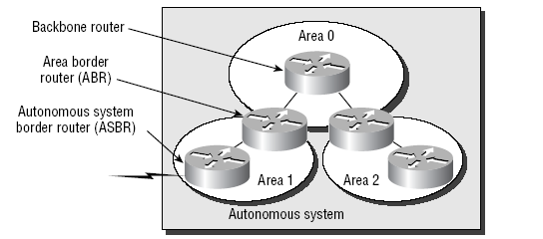
OSPF Design
Each router connects to the backbone called area 0, or the backbone area.
Routers that connect other areas to the backbone within an AS are called Area Border Routers (ABRs). One interface must be in area 0.
OSPF runs inside an autonomous system, but can also connect multiple autonomous systems together. The router that connects these ASes together is called an Autonomous System Boundary Router (ASBR).

Slide 11
OSPF Areas
An OSPF area is a grouping of contiguous networks and routers
  Share a common area ID
A router can be a member of more than one area (area border router)
All routers in the same area have the same topology database
When multiple areas exist, there must always be an area 0 (the backbone) to which other areas connect

Slide 12
Why areas?
Decreases routing overhead
  Compare to multiple smaller broadcast domains instead of one large one
Speeds convergence
Confines network instability (e.g. route "flapping") to single area of the network
Adds considerably to the complexity of setting up OSPF
  CCNA certification deals only with single-area OSPF

Slide 13

Types of OSPF Routers
Area 1
Backbone Area 0
Area 2
ABR and
Backbone
Router
Backbone/
Internal
Routers
Internal
Routers
Internal
Routers
ASBR and
Backbone
Router
ABR and
Backbone
Router
External
AS

Slide 14
Basic OSPF Configuration
Router(config)#router ospf process-id
Router(config)# router ospf 1
The number 1 in this example is a process-id # that begins an OSPF process in the router
  More than one process can be launched in a router, but this is rarely necessary
  Usually the same process-id is used throughout the entire network, but this is not required
  The process-id # can actually be any value from 1 to "very large integer“
  The process-id # cannot be ZERO
  This is NOT the same as the AS# used in IGRP and EIGRP
Router(config-router)#network address mask area area-id
Assigns networks to a specific OSPF area

Slide 15

OSPF Configuration -1
S0
S1
30.0.0.1
20.0.0.2
R2
R1
20.0.0.1
R3
S0
S0
40.0.0.1
30.0.0.2
E0
10.0.0.1
E0
40.0.0.2
10.0.0.2
R1#config t
Enter configuration commands, one per line. End with CNTL/Z.
R1(config)#router ospf 1
R1(config-router)#network 10.0.0.0 0.255.255.255 area 0
R1(config-router)#network 20.0.0.0 0.255.255.255 area 0
R1(config-router)#^Z

Slide 16
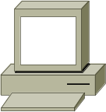
OSPF Configuration -2
S0
S1
200.0.0.13
200.0.0.10
255.255.255.252
R2
255.255.255.252
R1
R3
200.0.0.9
S0
S0
200.0.0.14
200.0.0.33
200.0.0.17
E0
E0
255.255.255.224
255.255.255.240
200.0.0.18
200.0.0.34
A
B
R1#config t
Enter configuration commands, one per line. End with CNTL/Z.
R1(config)#router ospf 1
R1(config-router)#network 200.0.0.16 0.0.0.15 area 0
R1(config-router)#network 200.0.0. 8 0.0.0.3 area 0
R1(config-router)#^Z
R3#config t
Enter configuration commands, one per line. End with CNTL/Z.
R3(config)#router ospf 1
R3(config-router)#network 200.0.0.32 0.0.0.31 area 0
R3(config-router)#network 200.0.0.12 0.0.0.3 area 0
R3(config-router)#^Z

Slide 17
Configuring Wildcards
If you want to advertise a partial octet (subnet), you need to use wildcards.
  0.0.0.0 means all octets match exactly
  0.0.0.255 means that the first three match exactly, but the last octet can be any value
After that, you must remember your block sizes….
The wildcard address is always one less than the block size….
  192.168.10.8/30 = 0.0.0.3
  192.168.10.48/28 = 0.0.0.15
  192.168.10.96/27 = 0.0.0.31
  192.168.10.128/26 = 0.0.0.63

Slide 18
Verifying the OSPF Configuration
Router#show ip protocols
Verifies that OSPF is configured
Router#show ip route
Displays all the routes learned by the router
Router#show ip ospf interface
Displays area-ID and adjacency information
Router#show ip ospf neighbor
Displays OSPF-neighbor information on a per-interface basis

Slide 19
RouterA# show ip route ospf
Codes: C - connected, S - static, I - IGRP, R - RIP, M - mobile,
B - BGP, D - EIGRP, EX - EIGRP external, O - OSPF,
IA - OSPF inter area, E1 - OSPF external type 1,
E2 - OSPF external type 2, E - EGP, i - IS-IS, L1 - IS-IS
level-1, L2 - IS-IS level-2, * - candidate default
Gateway of last resort is not set
10.0.0.0 255.255.255.0 is subnetted, 2 subnets
O 10.2.1.0 [110/10] via 10.64.0.2, 00:00:50, Ethernet0
RouterB# show ip ospf neighbor
Neighbor ID Pri State Dead Time Address Interface
10.64.1.1 1 FULL/BDR 00:00:31 10.64.1.1 Ethernet0
10.2.1.1 1 FULL/- 00:00:38 10.2.1.1 Serial0

